Slide 1
Bayesian Inference
Module 5, Lesson 3
Notes:
Welcome to Lesson 3 of module 5 of Bayesian Inference

Slide 2
Model Validation
Shahrzad Jamshidi, PhD
Notes:
In this lesson, we will be discussing model validation.

Slide 3
Last Time
Hierarchical models
Notes:
Last time, we discussed hierarchical models and walked through an example illustrating the normal-normal model.

Slide 4
Objectives
Develop computational skills for hierarchical models.
Perform model checking and apply methods for model improvement.
Notes:
By the end of this lesson, you will have some of the computational skills for hierarchical models and you will perform model checking and apply methods for model improvement.

Slide 5
Topics to Review
Normal-normal model
Pooled estimates
Histograms, pair plots, and trace plots
Notes:
Among the topics to review for this lesson, I would include the normal-normal model from the last lesson, pooled estimates, and several visualizations you’ve learned in other data science classes such as histograms, pair plots, and trace plots.

Slide 6
Example of Normal-Normal Model
Let’s discuss an example where the hierarchical normal model illustrates how Bayesian analysis gives conclusions that differ in important respects from other methods.
Study is from Educational Testing Services ETS
Study Purpose
Analyze effects of special coaching programs on SAT-V scores.
Separate randomized experiments conducted in eight high schools.
Notes:
We’ll start with an example where the hierarchical normal model illustrates how Bayesian analysis can yield different conclusions compared to other methods. This study was conducted by the Educational Testing Services (ETS) to analyze the effects of special coaching programs on SAT-V scores.
The purpose of the study was to analyze the effects of special coaching programs on SAT-V scores through separate randomized experiments conducted in eight high schools.

Slide 7
Context and Outcome Variable
Experiment Context
Each school considered its coaching program successful.
No prior belief that any program was more effective or similar to others.
Outcome Variable
SAT-V scores ranging between 200 and 800, mean ~500, standard deviation ~100.
Scores intended to reflect long-term knowledge and abilities, resistant to short-term coaching.
Notes:
Experiment Context
Each school considered its coaching program successful. There was no prior belief that any program was more effective than others, or that some were more similar to each other.
Outcome Variable
The outcome variable is the SAT-V score, which ranges between 200 and 800, with a mean around 500 and a standard deviation of about 100. These scores are designed to reflect long-term knowledge and abilities rather than short-term coaching.

Slide 8
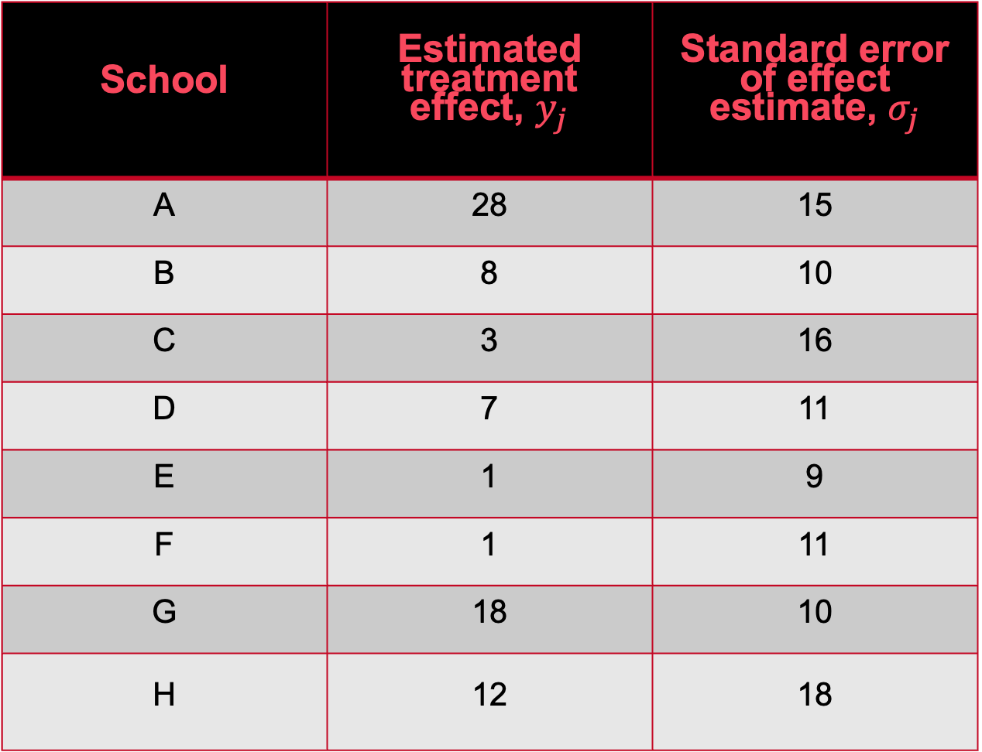
Data and Methodology
Students had previously taken the PSAT.
Adjustments made for PSAT-M and PSAT-V scores using analysis of covariance (linear regression of SAT-V on treatment group with PSAT scores as control variables).
Separate regressions estimated for each school.
An increase of eight points on the SAT-V corresponds to about one more correct test item.
School | Estimated treatment effect, $y_{j}$ | Standard error of effect estimate, $σ_{j}$
A | 28 | 15
B | 8 | 10
C | 3 | 16
D | 7 | 11
E | 1 | 9
F | 1 | 11
G | 18 | 10
H | 12 | 18
Data taken from BDA3
Notes:
Observed effects of special preparation on SAT-V scores in eight randomized experiments. Estimates are based on separate analyses for the eight experiments.
Estimates and Variances:
• Estimated coaching effects (y_j) and sampling variances (\sigma_j^2) used in the model.
• Estimates from independent experiments with approximately normal sampling distributions.
• Sampling variances known due to large sample sizes (over thirty students per school).

Slide 9
Alternatives to the Hierarchical Model
Before fitting the hierarchical Bayesian model, consider two simpler nonhierarchical methods
estimating the effects from the eight experiments independently, and
complete pooling
Let’s discuss why neither of these approaches is adequate for this example.
Notes:
Before fitting the hierarchical Bayesian model, let’s consider two simpler nonhierarchical methods: estimating the effects from the eight experiments independently, and complete pooling. Let’s discuss why neither of these approaches is adequate.

Slide 10
Separate Estimates
Some coaching programs have moderate effects (18–28 points).
Most have small effects (0–12 points).
Two have small negative effects.
Standard errors reveal difficulty in statistically distinguishing between experiments.
Applying simple normal analysis to each experiment separately:
95% posterior intervals overlap substantially, indicating no clear differences among the experiments.
Notes:
A cursory examination of data may at first suggest that some coaching programs have moderate effects (in the range 18–28 points), most have small effects (0–12 points), and two have small negative effects; however, when we take note of the standard errors of these estimated effects, we see that it is difficult statistically to distinguish between any of the experiments. For example, treating each experiment separately and applying the simple normal analysis in each yields 95% posterior intervals that all overlap substantially.

Slide 11
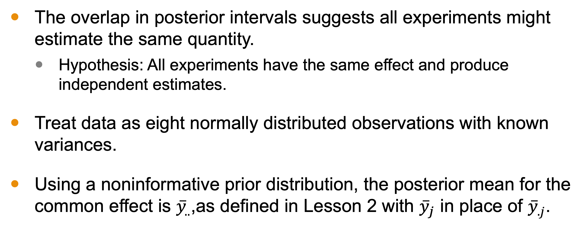
Pooled Estimate Setup
The overlap in posterior intervals suggests all experiments might estimate the same quantity.
Hypothesis: All experiments have the same effect and produce independent estimates.
Treat data as eight normally distributed observations with known variances.
Using a noninformative prior distribution, the posterior mean for the common effect is ${\overset{‾}{y}}_{..}$,as defined in Lesson 2 with ${\overset{‾}{y}}_{j}$ in place of ${\overset{‾}{y}}_{.j}$.
Notes:
The general overlap in posterior intervals suggests that all experiments might estimate the same quantity. Under this hypothesis, we treat the data as eight normally distributed observations with known variances.

Slide 12
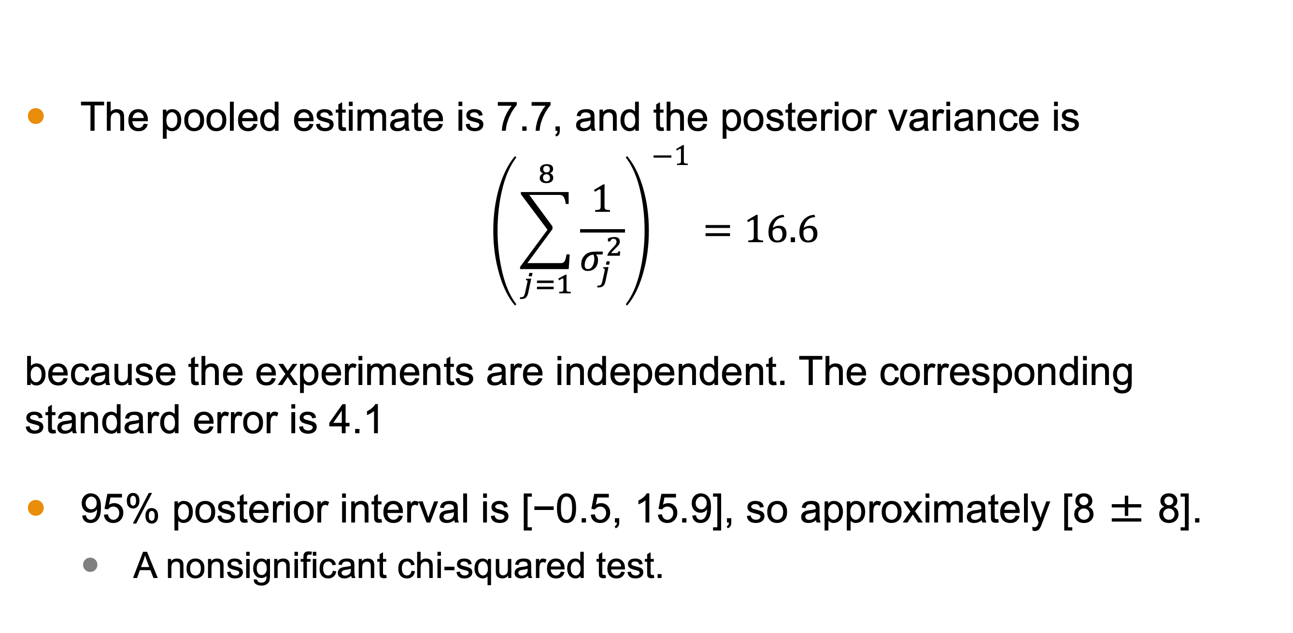
Pooled Estimate Results
The pooled estimate is 7.7, and the posterior variance is
$${\left( \sum_{j=1}^{8}{\frac{1}{σ_{j}^{2}}}\right)}^{−1}=16.6$$
because the experiments are independent. The corresponding standard error is 4.1
95% posterior interval is [−0.5, 15.9], so approximately [8 ± 8].
A nonsignificant chi-squared test.
Notes:
The pooled estimate for the common coaching effect in the schools is 7.7 points with a standard error of 4.1. The 95% posterior interval is [-0.5, 15.9], suggesting no significant effect.

Slide 13
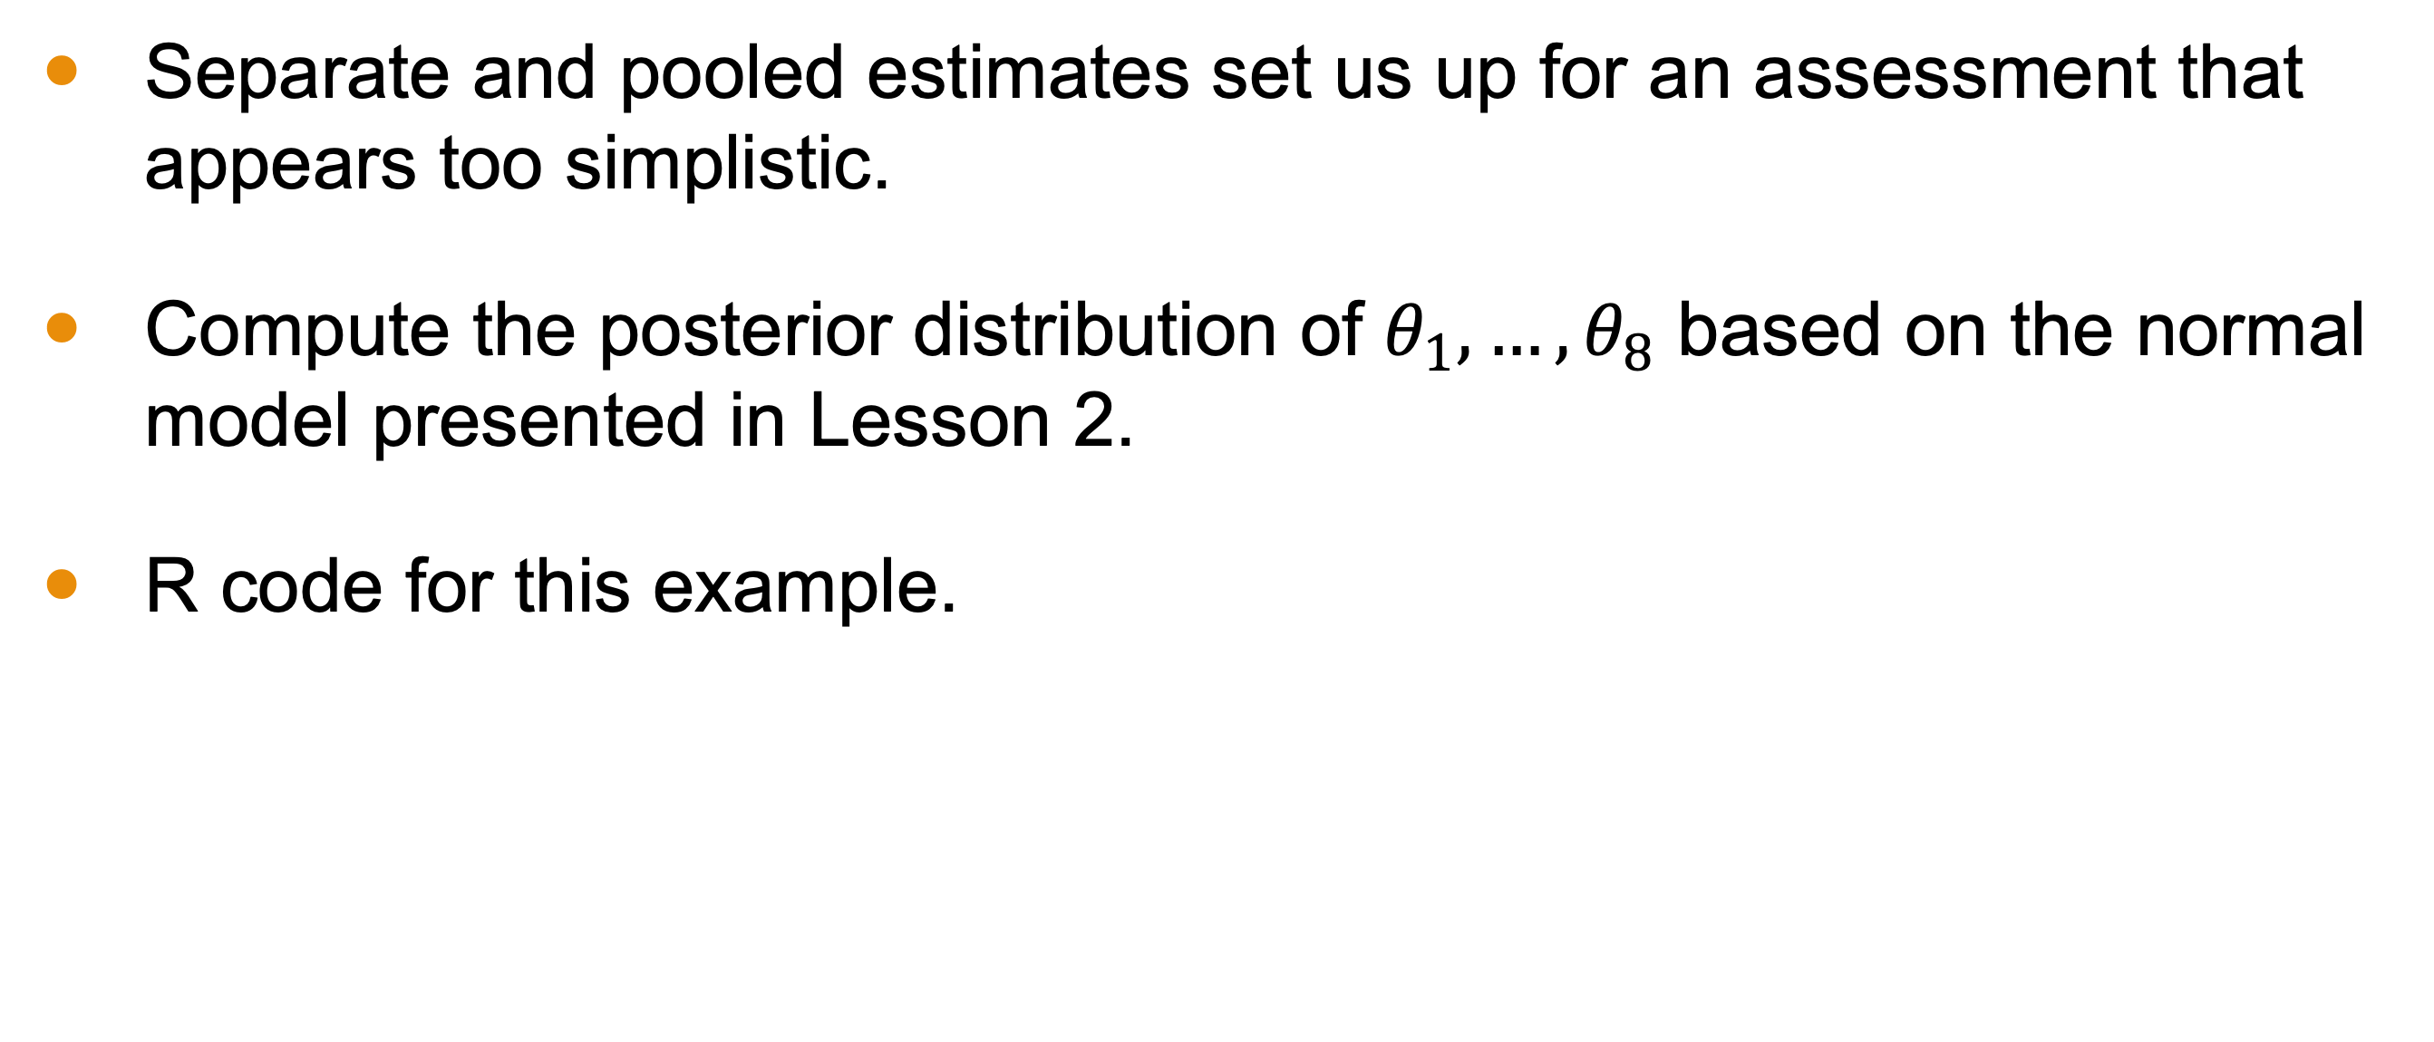
Bayesian Analysis under Hierarchical Model
Separate and pooled estimates set us up for an assessment that appears too simplistic.
Compute the posterior distribution of $θ_{1},…,θ_{8}$ based on the normal model presented in Lesson 2.
R code for this example.
Notes:
Both separate and pooled estimates set us up for an assessment that appears too simplistic. We then compute the posterior distribution of the effects based on the normal model.

Slide 14
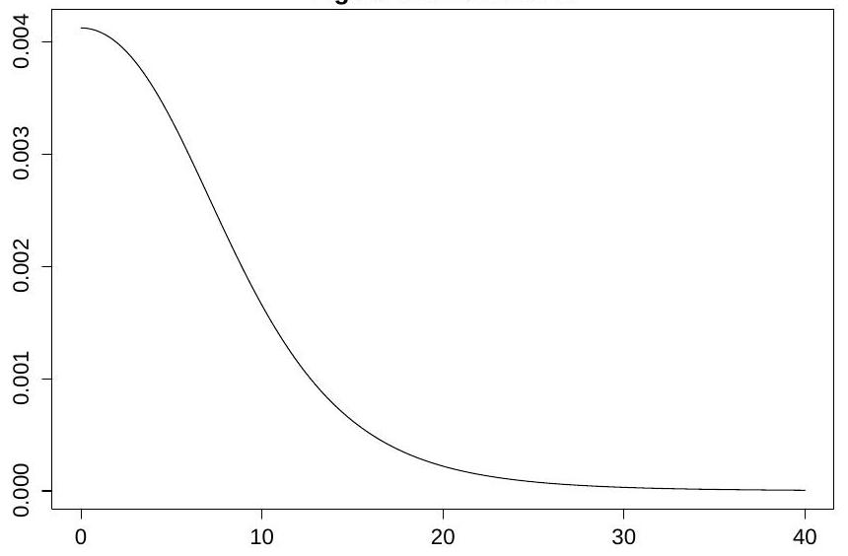
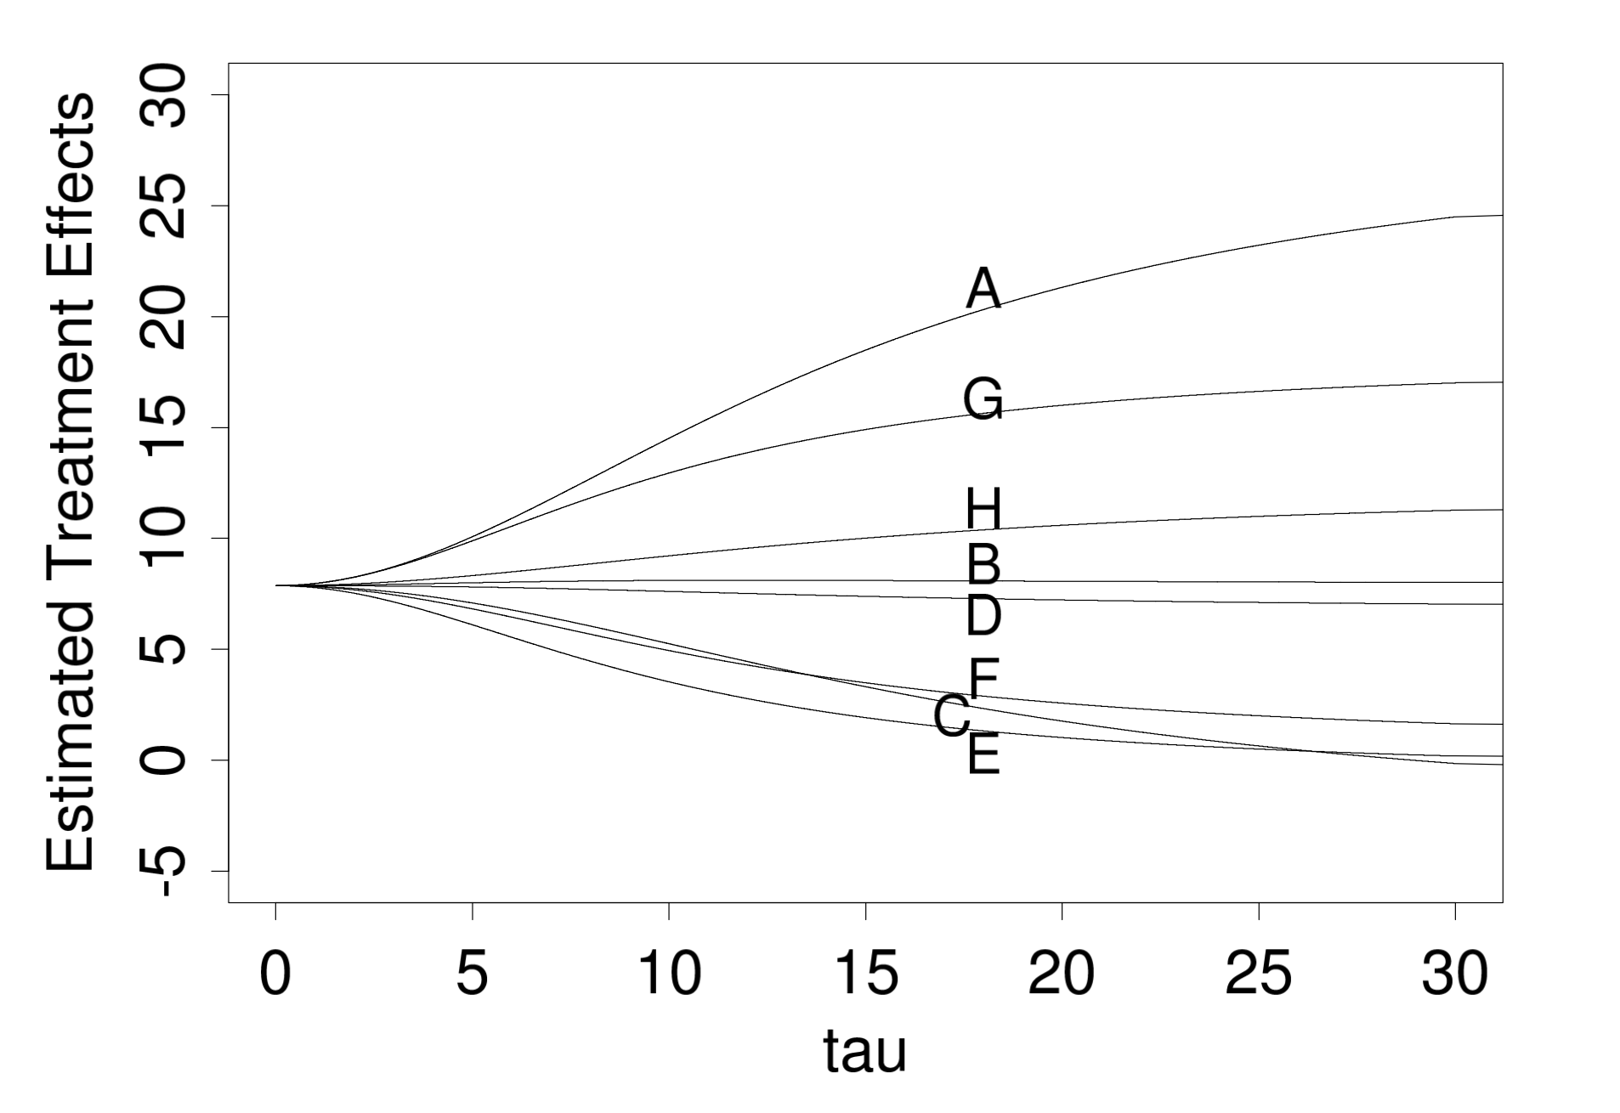
Summary of the Model
Taken from BDA3
Taken from BDA3
Notes:
On the left, we see the Marginal posterior density, p(τ|y), for standard deviation of the population of school effects θj in the educational testing example.
Conditional posterior means of treatment effects, E(θj |τ, y), as functions of the between- school standard deviation τ, for the educational testing example. The line for school C crosses the lines for E and F because C has a higher measurement error (see Table 5.2) and its estimate is therefore shrunk more strongly toward the overall mean in the Bayesian analysis.

Slide 15
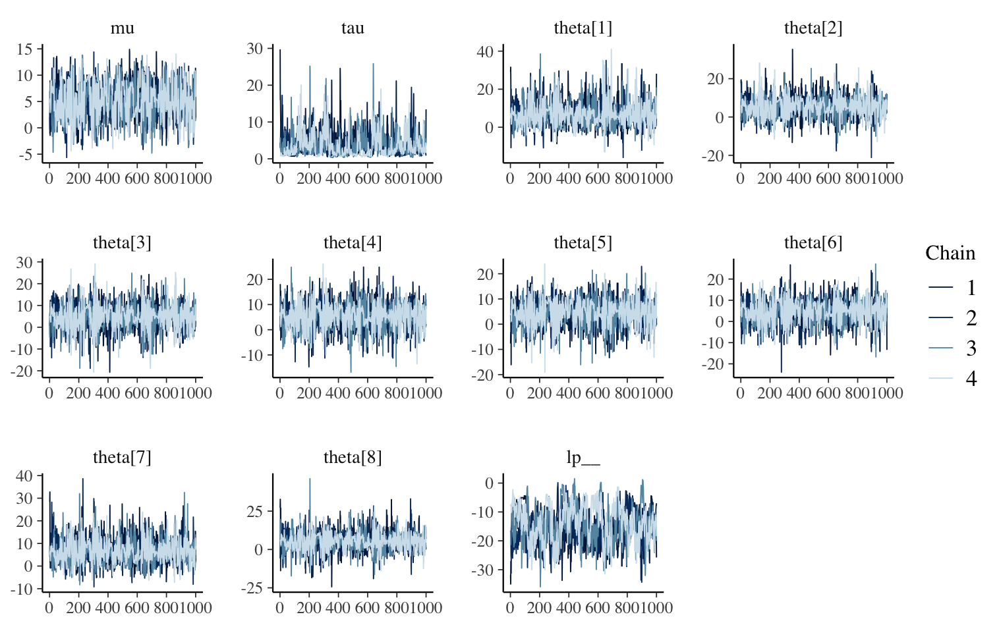
Results
School | 2.5% | 25% | 50% | 75% | 95%
A | -2.47 | 3.35 | 6.34 | 9.47 | 20.04
B | -4.10 | 2.59 | 5.43 | 8.19 | 15.30
C | -6.18 | 1.90 | 4.86 | 7.77 | 14.43
D | -4.44 | 2.55 | 5.30 | 8.30 | 14.63
E | -5.46 | 1.73 | 4.62 | 7.61 | 13.24
F | -5.78 | 1.65 | 4.77 | 7.66 | 14.02
G | -1.86 | 3.61 | 6.40 | 9.47 | 17.84
H | -5.42 | 2.41 | 5.29 | 8.22 | 16.60
Notes:
Trace Plots: Trace plots are used to diagnose the convergence of the MCMC algorithm. They show the sampled values of each parameter across the iterations of the MCMC chains. A well-mixed and stationary trace plot, where the chains move freely around the parameter space, indicates good convergence. Conversely, patterns or trends in the trace plots might indicate issues with convergence.
Here are results summarizing the postierior distribution with respect to the theta_js. You may get slightly different numbers when you run your simulation and you’ll notice that these are distinct from the book.

Slide 16
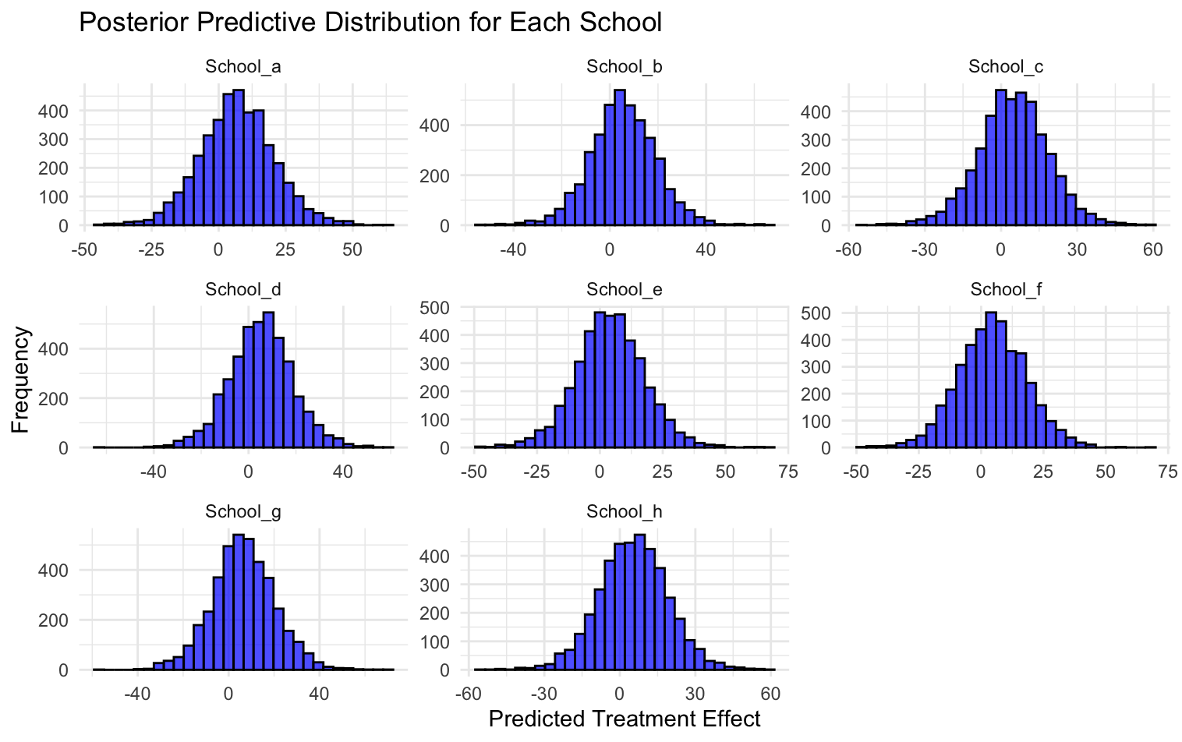
Posterior Predictive Distributions
Future data from current experiments
Notes:
We use posterior predictive distributions to estimate future data from the current experiments, providing insights into the expected outcomes.

Slide 17
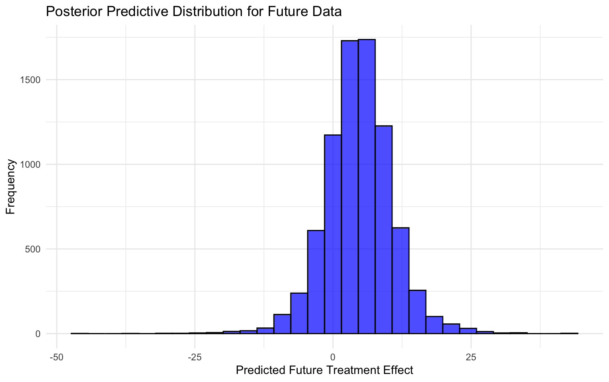
Posterior Predictive Distributions
Future data from future experiment with 30 samples
Notes:
Similarly, we estimate future data from future experiments with new sample sizes using posterior predictive distributions.

Slide 18
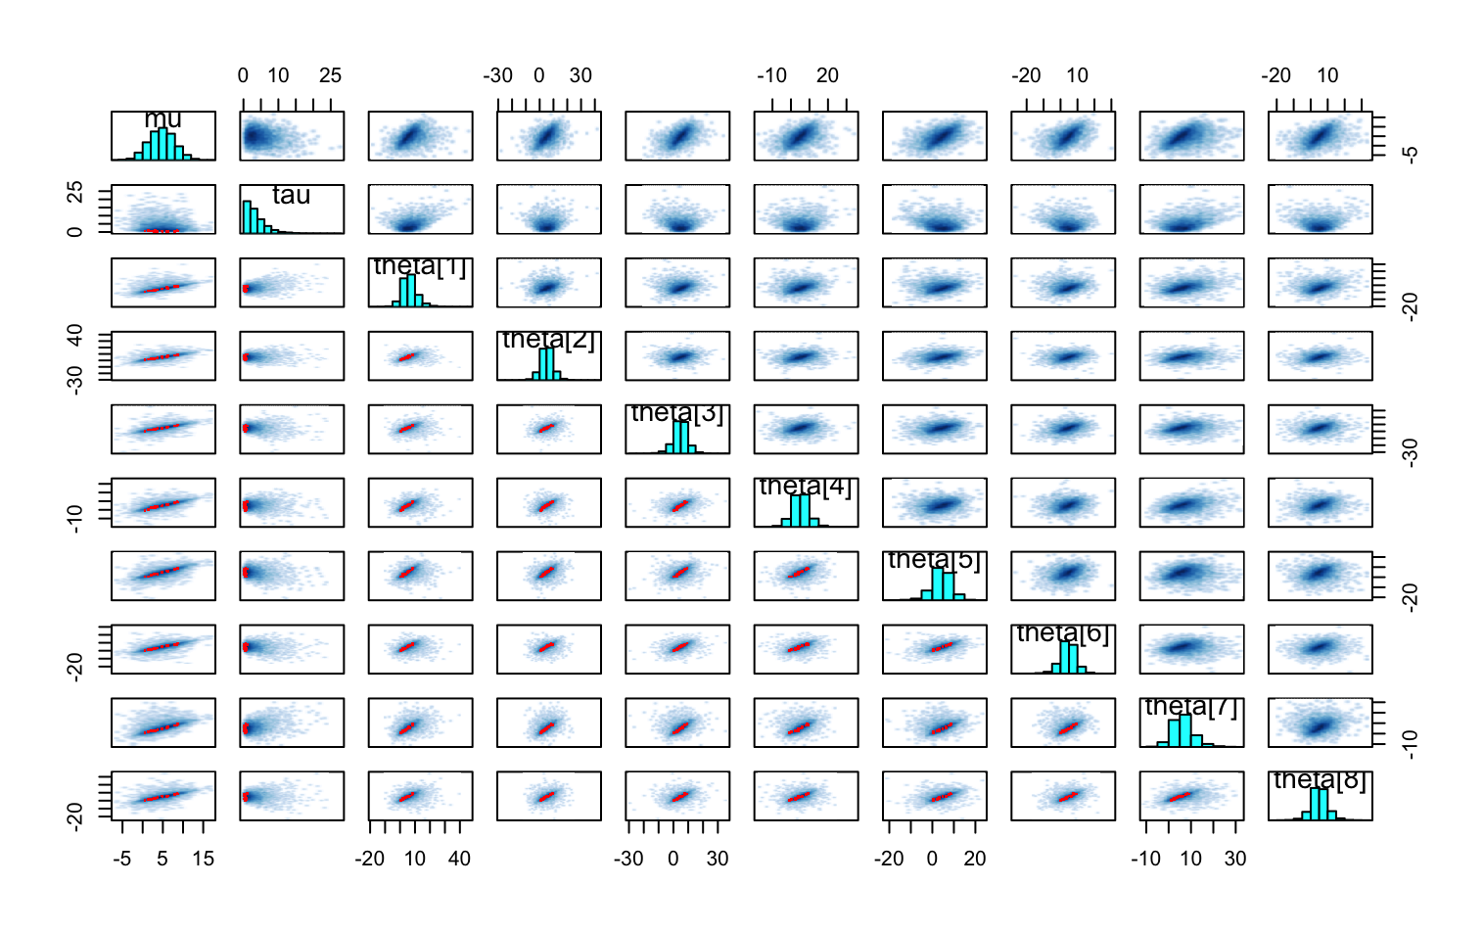
Pair Plots for Assessment
Pair plots are useful diagnostic tools for assessing the quality of a Bayesian model’s sampling process.
Notes:
Pairs plots (scatterplot matrices) are useful diagnostic tools for assessing the quality of a Bayesian model’s sampling process. They allow you to visualize pairwise relationships between parameters and identify potential issues such as divergent transitions, strong correlations, or non-converging chains.
Diagonal Panels: These panels show the histograms or kernel density plots of the marginal distributions of each parameter.
• Off-Diagonal Panels: These panels show scatterplots of pairs of parameters.

Slide 19
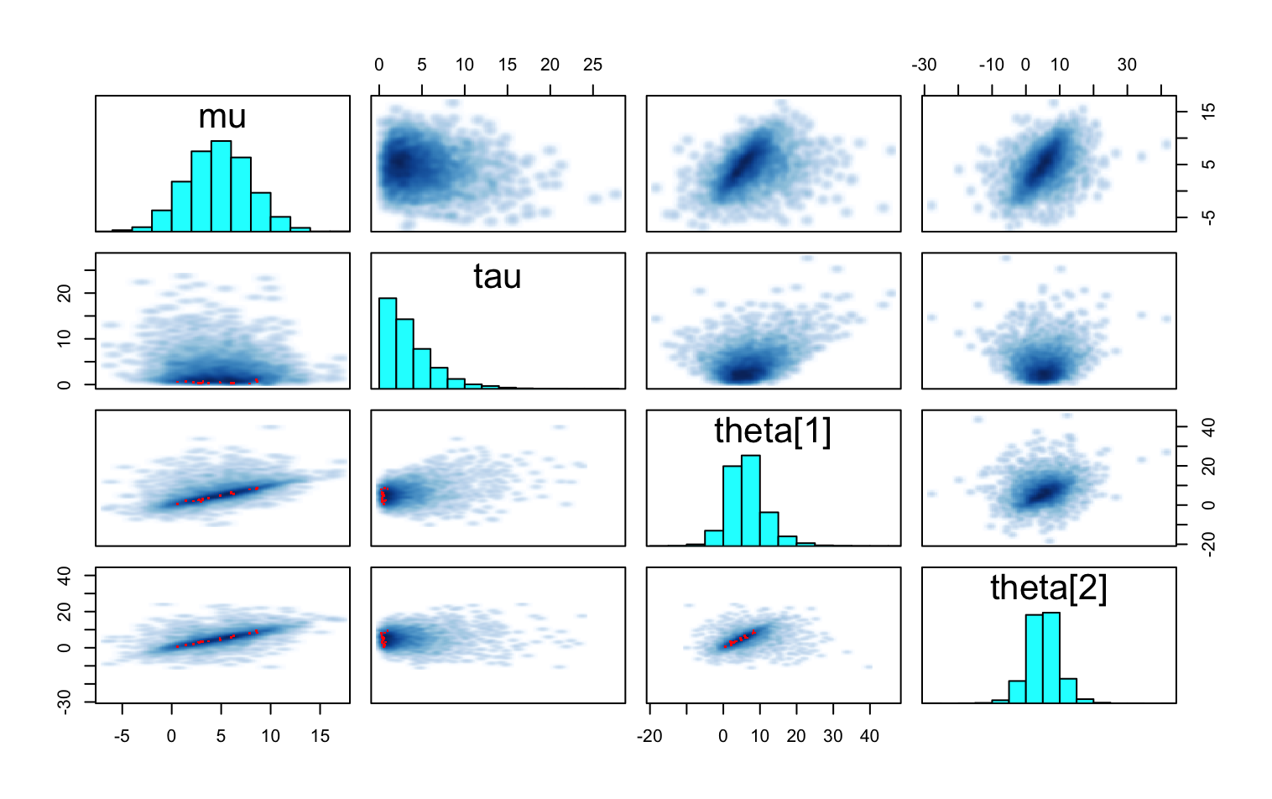
Divergent Transitions and Correlations
Red points represent divergent transitions.
Areas where the sampler had trouble exploring.
Strong linear patterns indicate high correlation
This can hinder efficient sampling.
Notes:
. Divergent Transitions:
• Red Points: If there are any red points, they represent divergent transitions. These indicate areas where the sampler had trouble exploring the posterior distribution.
• Clusters of Red Points: Clusters of red points in certain regions suggest problematic areas in the posterior landscape.
2. Parameter Correlations:
• Strong Correlations: Look for linear patterns in the scatterplots. Strong linear patterns (positive or negative) indicate high correlation between parameters, which can hinder efficient sampling.
• Funnel Shapes: Funnel shapes or other non-linear patterns can also indicate problematic posterior geometries.
3. Non-Converging Chains:
• Separate Clusters: If you see distinct clusters of points in the scatterplots, it suggests that the chains have not mixed well and might not have converged to the same posterior distribution.
4. Effective Sample Size (ESS):
• Low ESS: Low ESS values can often be linked to strong correlations or problematic posterior geometries visible in the pairs plot.
Low ESS is a problem we see in this simulation, but we may be able to alleviate it somewhat by increasing the sampling.

Slide 20
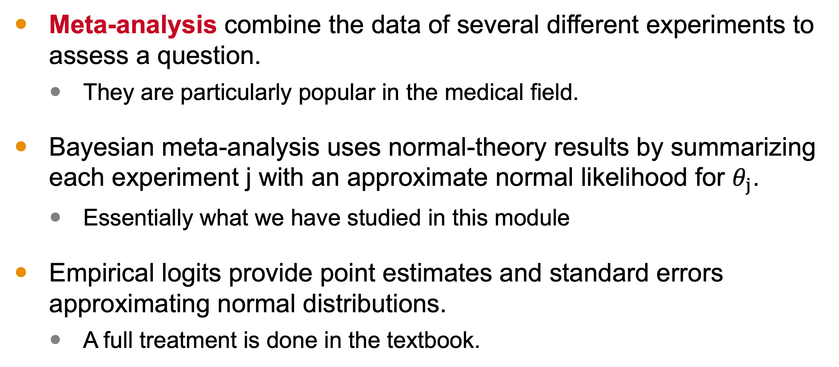
Hierarchical Modeling for Meta-Analyses
Meta-analysis combine the data of several different experiments to assess a question.
They are particularly popular in the medical field.
Bayesian meta-analysis uses normal-theory results by summarizing each experiment j with an approximate normal likelihood for $θ_{j}$.
Essentially what we have studied in this module
Empirical logits provide point estimates and standard errors approximating normal distributions.
A full treatment is done in the textbook.
Notes:
Meta-analysis are a type of study that combine data from several experiments to assess a question. It is very popular in the medical field.
Bayesian meta-analysis uses normal-theory results by summarizing each experiment with an approximate normal likelihood.
Essentially what we’ve done in this module.
Empirical logits provide point estimates and standard errors approximating normal distributions.
A full treatment is done in the textbook, which I highly recommend.

Slide 21
Next Time
Bayesian Computation
Notes:
In our next module, we will discuss Bayesian Computation.

